Slide 1
Introductory
2024
单击此处输入你的正文，文字是您思想的提炼。
LIU Yang

Slide 2


Aims
1
Introduction to the integration between structure and function among all levels of biological organization.
2
Application of principles of evolution, genetics, physiology and ecology to understanding the integrated and interdependent nature of living systems through discussions emphasizing the process of science.
3
Current issues and local research and observation and investigation in both lecture and lab.

Slide 3
Contents
l Unit 1 Science, Chemistry, and Cells l Unit 2 DNA, Inheritance,and Biotechnology l Unit 3 The Evolution of Life l Unit 4 The Diversity of Life l Unit 5 Plant Life l Unit7 The Ecology of Life

Slide 4
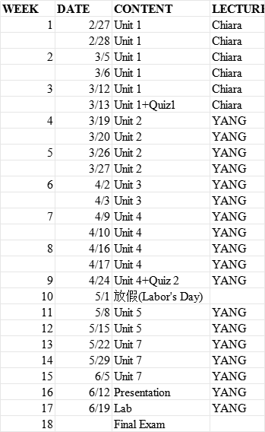
Calender

Slide 5
Grading
Content of Grading | Percentage
Lab Reports | 10
Presentation | 10
Home Work | 20
Class Performence and Attendance | 20
Quiz 1 | 10
Quiz 2 | 10
Final Exam | 20

Slide 6
First Presentation
To summarize the content given by teacher last week, and give a list of important vocabularies no less than 30 in last week’s course.
Requirements:
!0~12 minutes per group
Everyone need to express yourself and your performance would be graded
Every Wednesday from the 5th week to 15th week (last two group)

Slide 7
Final Presentation
Issues
A new technique in environmental biology
A new discovery in environmental biology
Biological processes in sewage treatment
Biological processes in solid waste treatment
Achievements of ecological protection in China in the past decade (ecological construction direction)
Achievements of biodiversity protection in China in the past decade
Requirements:
!0~12 minutes
Everyone need to express yourself and your performance would be graded
It will be hold in the 16th week

Slide 8
THANKS
感谢观看

